Slide 1
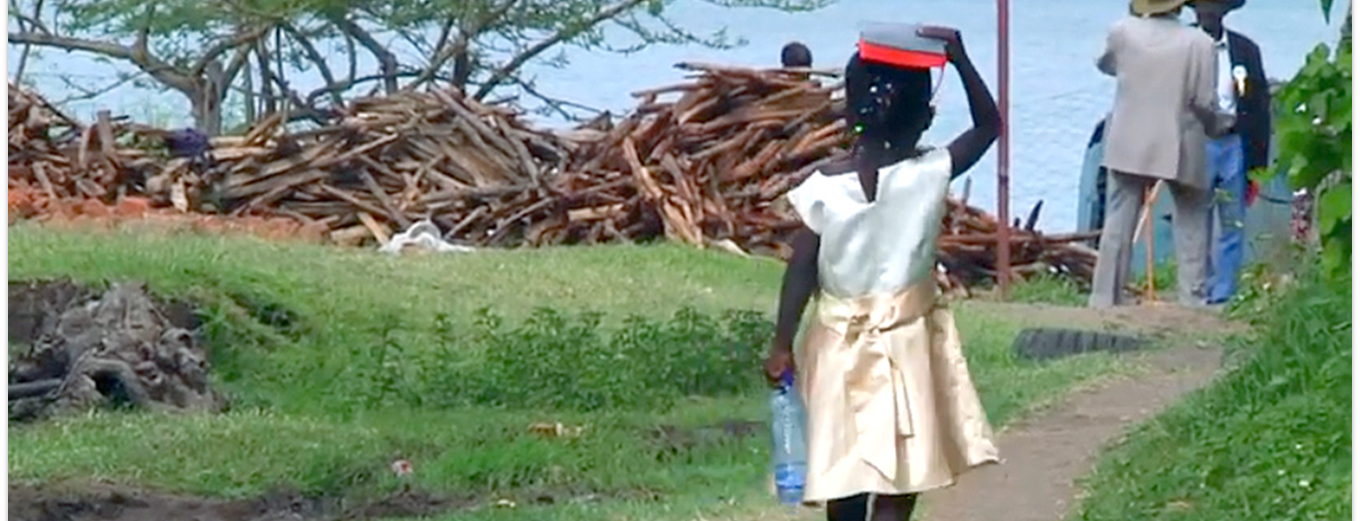
And the LORD commanded us to observe all these statutes, to fear the LORD our God, for our good always, that He might preserve us alive, as it is this day. Then it will be righteousness for us, if we are careful to observe all these commandments before the LORD our God, as He has commanded us (Deut. 6:24-25).
Therefore whoever hears these sayings of Mine, and does them, I will liken him to a wise man who built his house on the rock: and the rain descended, the floods came, and the winds blew and beat on that house; and it did not fall, for it was founded on the rock (Matt. 7:24-25).
Now the purpose of the commandment is love from a pure heart, from a good conscience, and from sincere faith (1 Tim. 1:5).
All Scripture is taken from the New King James Version®. © 1982 by Thomas Nelson, Inc. Used by permission. All rights reserved.
Scripture Engagement

Slide 2
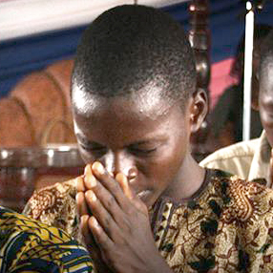
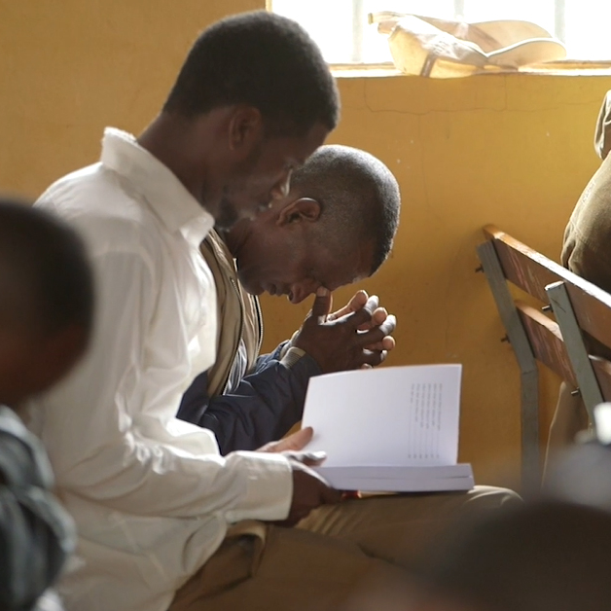
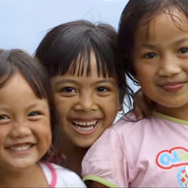
?
At church
How will the community engage with Scripture?
In Sunday school or small groups
In homes / with children

Slide 3

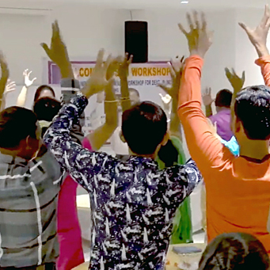
Community Change Through Scripture
More believers
Increased hope and expectation
Increased church attendance
Sinful behaviors decrease
More baptisms

Slide 4
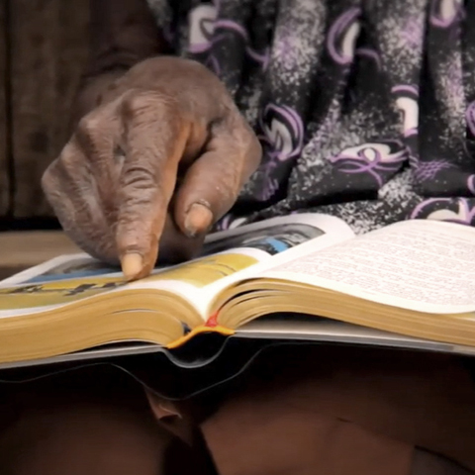
Help the Community Use Scripture
Application Guides:
Scripture questions that apply to every-day life

Slide 5
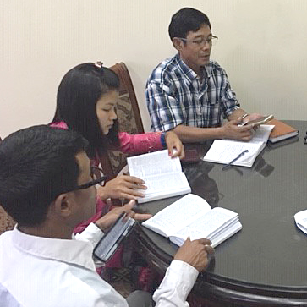
Gauge and Celebrate Change
Biblical Impact Questionnaire:
Survey to assess change from Scripture use

Slide 6
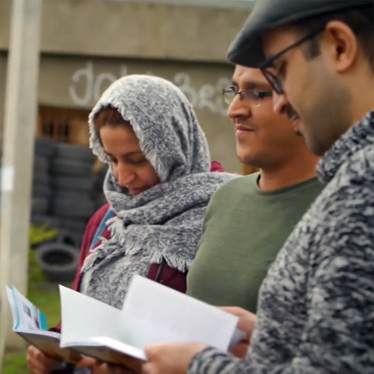
Include Others in Scripture Use
Read Acts 8:27-38
Apply this to plans for Scripture in community

Slide 7
Acts 8:27-38
So he arose and went. And behold, a man of Ethiopia, a eunuch of great authority under Candace the queen of the Ethiopians, who had charge of all her treasury, and had come to Jerusalem to worship, 28 was returning. And sitting in his chariot, he was reading Isaiah the prophet. 29 Then the Spirit said to Philip, “Go near and overtake this chariot.”
30 So Philip ran to him, and heard him reading the prophet Isaiah, and said, “Do you understand what you are reading?”
31 And he said, “How can I, unless someone guides me?” And he asked Philip to come up and sit with him. 32 The place in the Scripture which he read was this:
“He was led as a sheep to the slaughter; And as a lamb before its shearer is silent, So He opened not His mouth.

Slide 8
33 In His humiliation His justice was taken away, And who will declare His generation? For His life is taken from the earth.”
34 So the eunuch answered Philip and said, “I ask you, of whom does the prophet say this, of himself or of some other man?” 35 Then Philip opened his mouth, and beginning at this Scripture, preached Jesus to him. 36 Now as they went down the road, they came to some water. And the eunuch said, “See, here is water. What hinders me from being baptized?”
37 [a]Then Philip said, “If you believe with all your heart, you may.”
And he answered and said, “I believe that Jesus Christ is the Son of God.”
38 So he commanded the chariot to stand still. And both Philip and the eunuch went down into the water, and he baptized him.

